Slide 1
LANDSLIDE DETECTION MODEL

Slide 2
IDEA / TEAM DETAILS:- DOMAIN :- INFRASTRUCTURE PROBLEM STATEMENT:- LANDSLIDE DETECTION TEAM NAME:- Technical Wizards TEAM LEADER:- UTKARSH SAXENA TEAM MEMBERS:- YASHIKA MISHRA , YASH JAIN , MOHIT SHARMA, SHIVANG RASTOGI COLLEGE :- IMS ENGINEERING COLLEGE (GHAZIABAD UP) COLLEGE CODE:- 143

Slide 3
CONTENTS
INTRODUCTION
OBJECTIVE
ABSTRACT
BLOCK DIAGRAM
PROPOSED SYSTEM
MATERIAL USED
ADVANTAGES

Slide 4
INTRODUCTION- PROBLEM STATEMENT
We all know that landslide is one of the natural disaster which causes destruction in terms of loss property.
Landslide affects around 0.49 million km2 covering nearly 15% of the land area of our country
The recent landslide occurred in the village of Uttrakhand killed around 134 people besides loss to the property and livestock.
Landslides of different types,due to earthquake,heavy rainfall and cloud burst are frequent in geo-dynamically active domains in the Himalayan and other mountainous parts of India .

Slide 5
OBJECTIVE
To monitoring and detect possibilities of landslide using appropriate sensors and controller and provide warning to people through different mediums.

Slide 6
ABSTRACT
* The system focuses on monitoring landslide and generate warning using sensors
And controller.
*This will generates warning when level of earth vibrations and
when the humidity level of soils goes beyond normal range.
*The sensors outputs are given to the control unit.
*Arduino uno controller is used to controlling the whole system.
*If the sensor detect vibration or rise in moisture level the buzzer will be beep and show danger message.

Slide 7
PROPOSED SYSTEM
This system used to monitoring Landslide by Arduino uno controller.
The sensors used here to monitoring earth vibration is VIBRATION SENSOR and moisture content using soil moisture sensor .
The outputs of sensors are given to Arduino controller.
MODEL TYPE – HARDWARE.

Slide 8
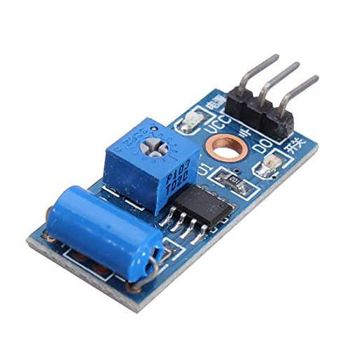
MATERIAL USED
VIBRATION SENSOR(SM-420)
*Vibration sensor is used to detect vibration of rocks and soil .
*Digital output is given by vibration sensor

Slide 9
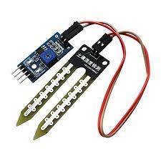
SOIL HUMIDITY SENSOR
*This sensor is tell us the moisture content of the soil.
*They are small,inexpensive,low-power,easy to use and don’t wear out.
*analogue output is given by this sensor.

Slide 10
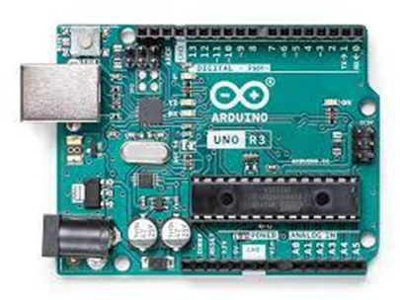
ARDUINO UNO
*The Arduino Uno is a microcontroller board based on the ATmega328.
*It has 14 digital input /output pins (of which 6 can be used as PWM
outputs),6analog inputs,a16MHz ceramic resonator,a USB connection,
a power jack,an ICSP header,and a reset button.
*It contains everything needed to support the microcontroller.
*Simply connect it to a computer with USB cable or power it with a AC
to DC adapter or battery to get started.

Slide 11
BLOCK DIAGRAM
LCD SCREEN
AURIDINO
UNO
SENSORS
BUZZER
POWER SUPPLY

Slide 12
ADVANTAGES OF PROPOSED SYSTEM
Low cost.
Reliable circuit.
High performance.
Easy operation.

Slide 13
CONCLUSION
This project can be successfully designed .
It can be great tool to warn humans about landslide and safe their lifes.
This method concludes the recent technological advances in communication.
Made new trends in the disaster monitoring system.

Slide 14


FROM:- TEAM:- Technical Wizards

